Slide 1


Reproducible analysis of microbial communities from plants exposed to the stress hormone methyl jasmonate
Pedro Beschoren da Costa, PhD
Marcela Aragon Gomes, Msc
Zulema Carracedo Lorenzo, Msc
Karen Kloth, PhD
Prof. Marcel Dicke
A framework for microbial community analysis – overview of updated analysis methods– MICROP data example

Slide 2
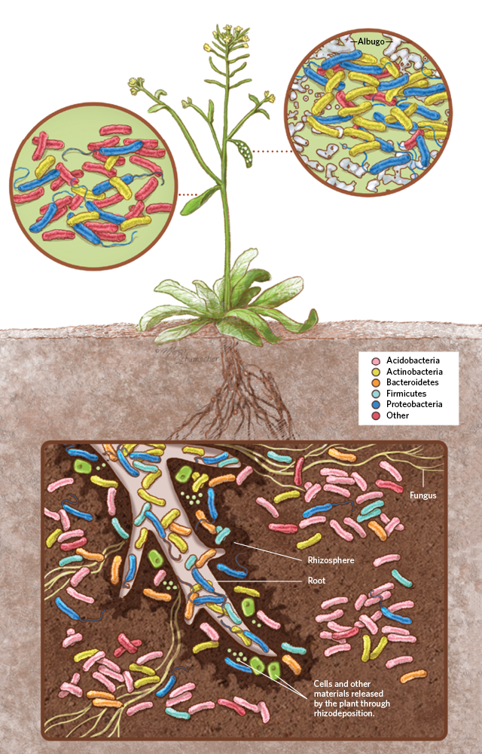
Plants were born in a microbial world
Plants cannot avoid interference from microbes
When plants first colonized the land, bacteria were already there for billions of years
Likewise, insect herbivores has been coevolving with microbe-associated plants since they first appeared
The microbiome is a secondary and flexible genome the plant can manipulate, with implications for agriculture
Microbes perform different functions: nutrient acquisition, pathogen defense, plant hormone regulation & others

Slide 3
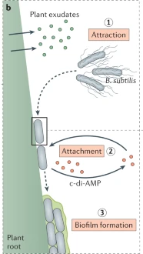
The microbial world is NOT lonely!
Humongous diversity of microbes in soil
Microbes won’t be functioning in isolation
Biofilms provide physical protection and an interaction matrix
Quorum sensing
Syntrophy
Desiccation resistance
Transfer of genetic elements
Bacteria have direct interactions with plant hormones
ACC (1-aminocyclopropane-1-carboxylate) deaminase
Catalyzes ACC (precursor of ethylene) to ammonia and α-ketobutyrate
Modulation of ethylene levels improves plant growth

Slide 4
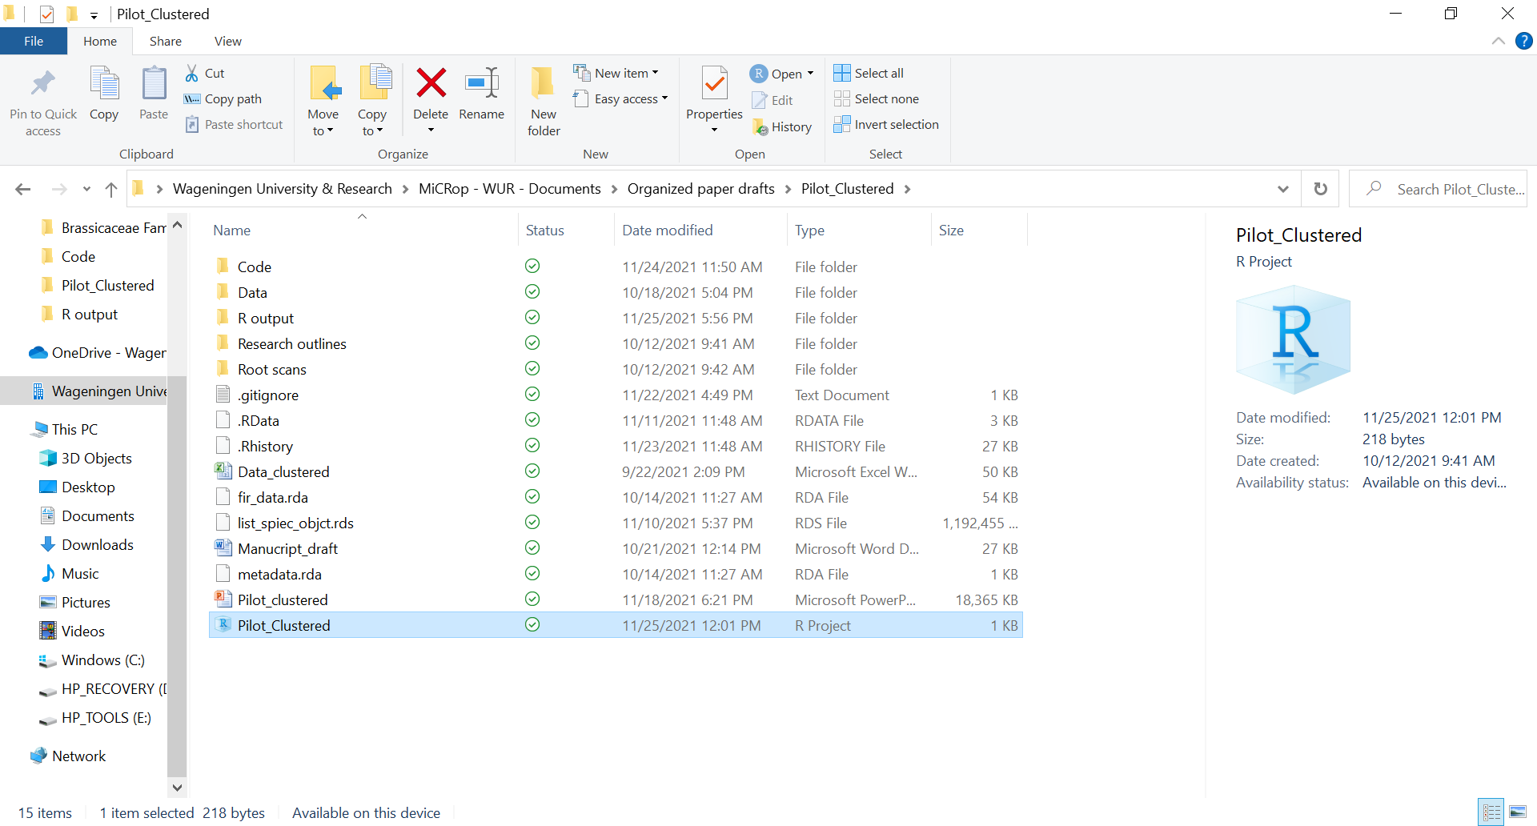
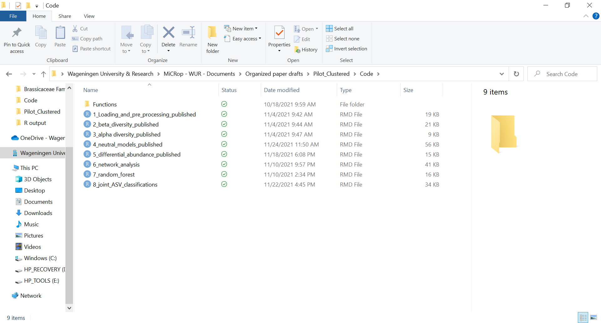
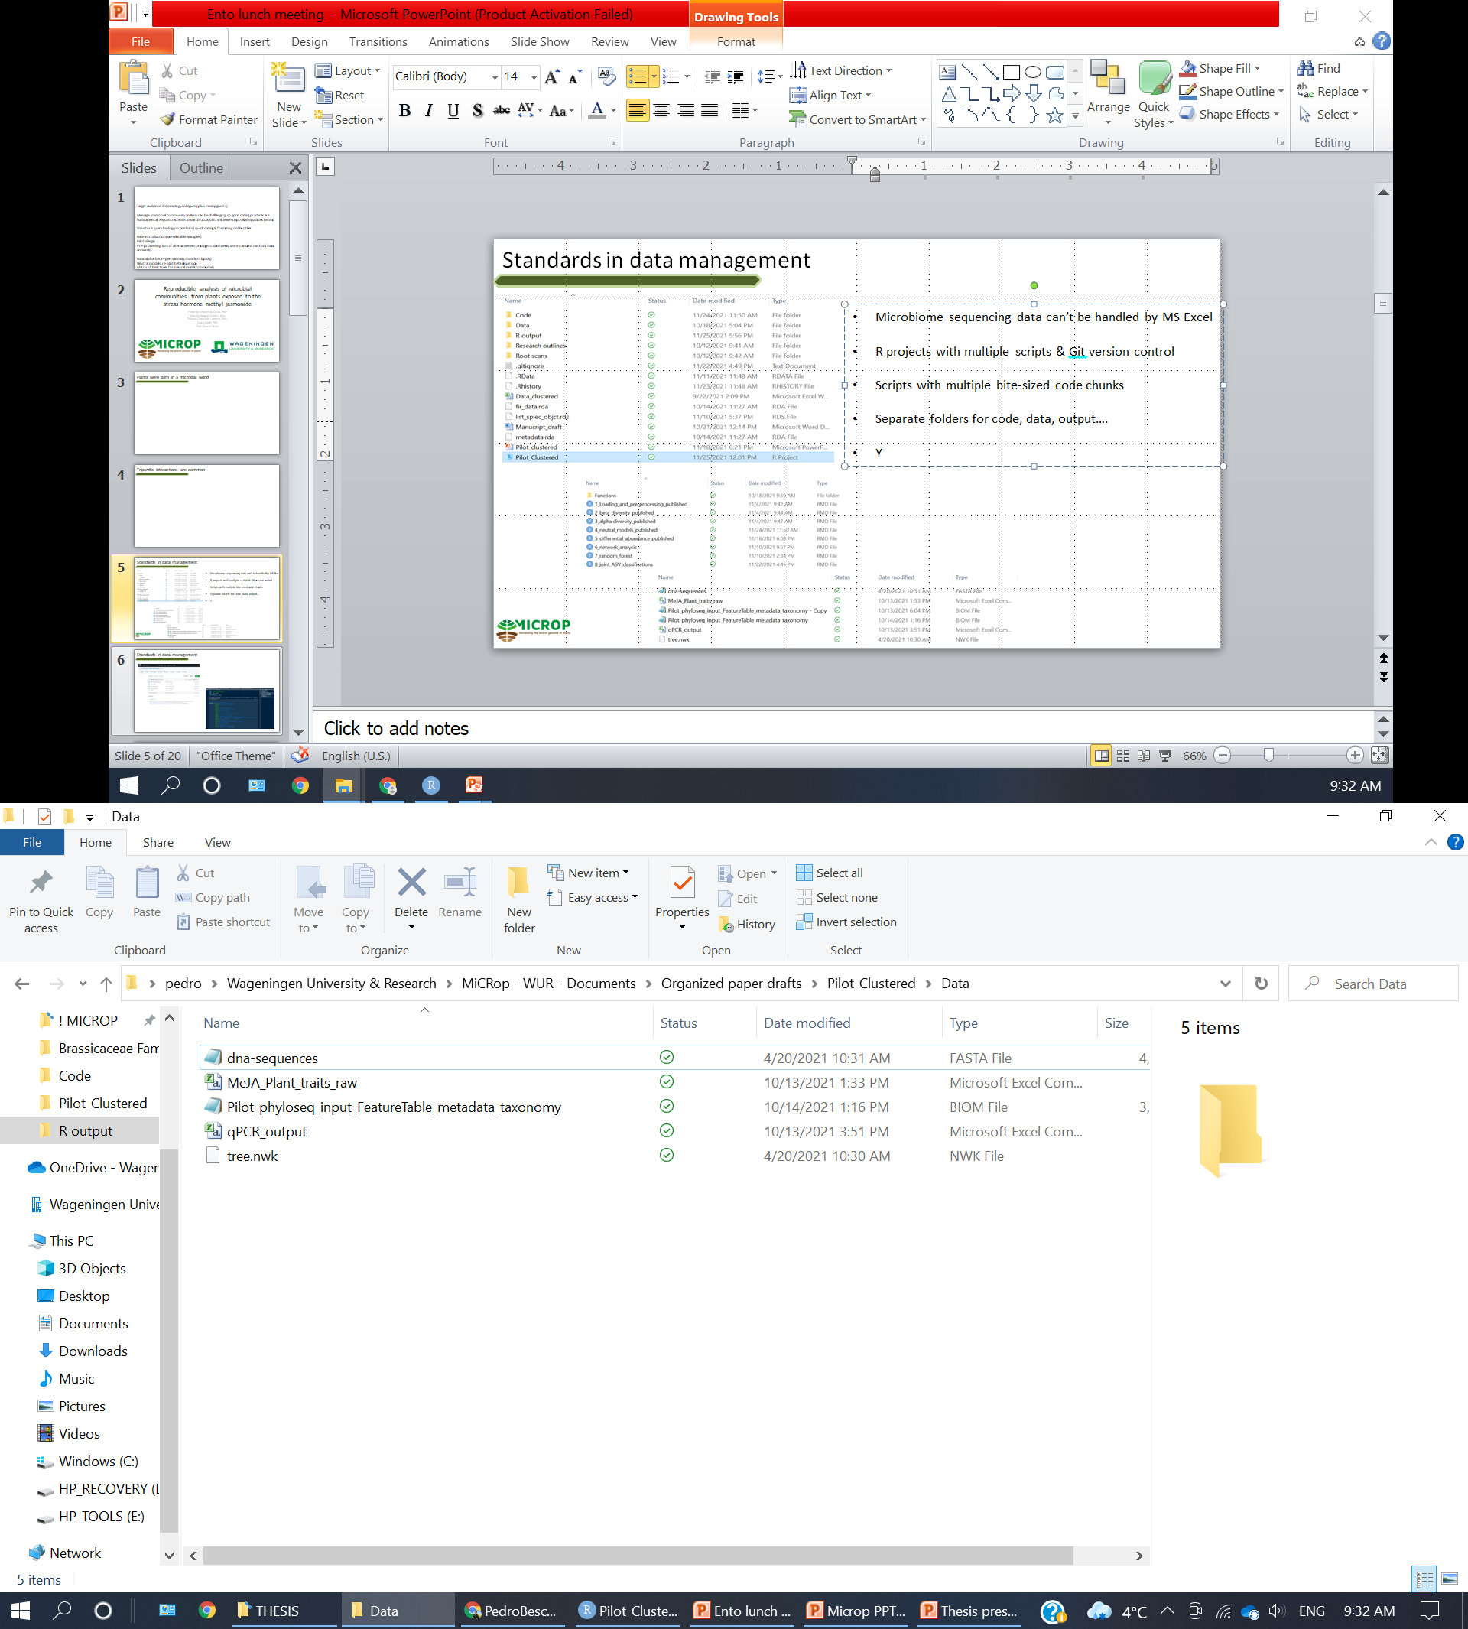
Standards in data management
15 years of advances in sequencing technology made microbiome analysis affordable & acessible
Microbiome sequencing data is big data - it can’t be handled by MS Excel and requires detailed processing records
Good data management & coding is like a good lab protocol
A framework for future microbiome projects in Ento
R projects with separate folders for code, data, output….
Multiple scripts with many small code chunks
Version control with Git and sharing with GitHub

Slide 5
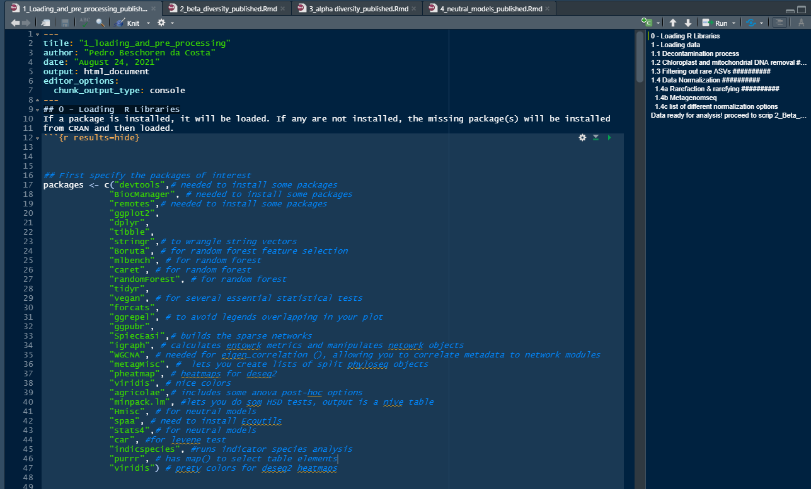
Scripts, instructions and guides for you!
R scripts in markdown documents with numbered summaries, filled with comments for you!
You only need a few packages to perform basic analysis of microbial communities
There are many tutorials – this is one of them
Publically available in a couple months

Slide 6
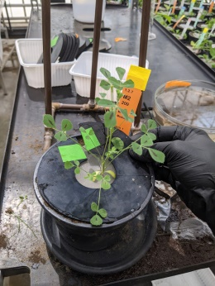
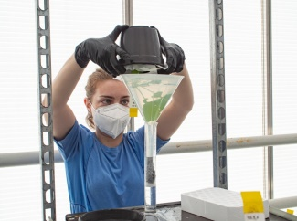

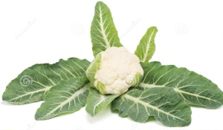
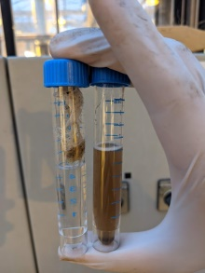
Exposing plants to methyl jasmonate by dipping
MeJA application
Sampling
Seed stratification (4C)
Seedlings planted
in trays
Transplant & growth
(44)
(44)
(24)
(24)
Leaf disc sampling 72 hours after last exposure (MeJA/caterpillar)
q-PCR of LOX2, MYC2
(24)
(24)
Arabidopsis thaliana
Brassica oleracea Riviera cvar
(6)
(6)
(6)
(6)
Control (mock)
0.1mM MeJA
1mM MeJA
Oral secretion
+ wounding
Pilot experiment for a larger project with many plant species
Methyl jasmonate as a mimic of insect attack
It triggers the Jasmonic Acid defense pathway plants use to combat herbivory
We needed to know a hormone concentration that would cause shifts in microbial community
Pipette secretion
on wounds
Dipping in 0.015% Silwet 4 dipping events, 2-day interval
Root and rhizosphere soil DNA extraction
16S amplification and sequencing with Baseclear

Slide 7
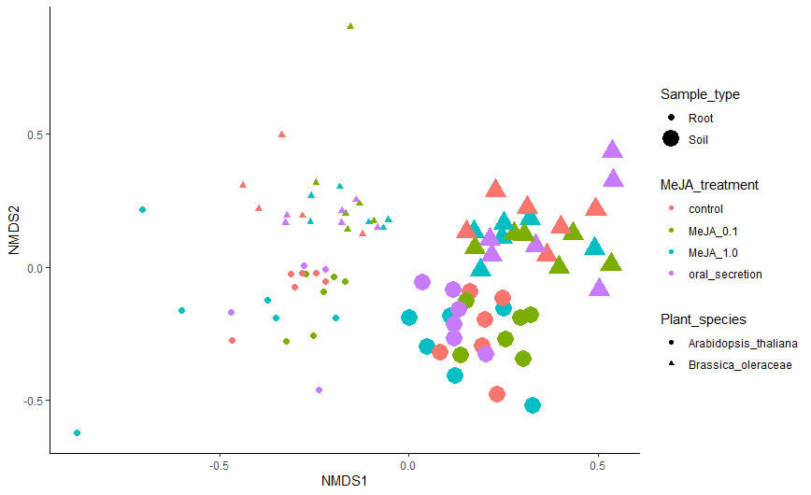
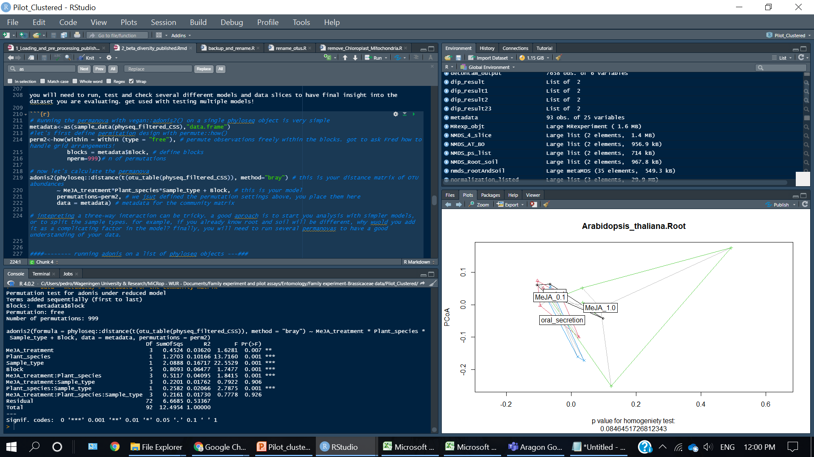
Clear clustering by plant species and root/soil samples, as expected
Dimension reduction (like PCA)
Samples with similar microbial communities cluster together
Load your data with the phyloseq package
phyloseq::ordinate() and phyloseq::plot_ordination()
vegan::adonis() for multivatiare statistical tests

Slide 8
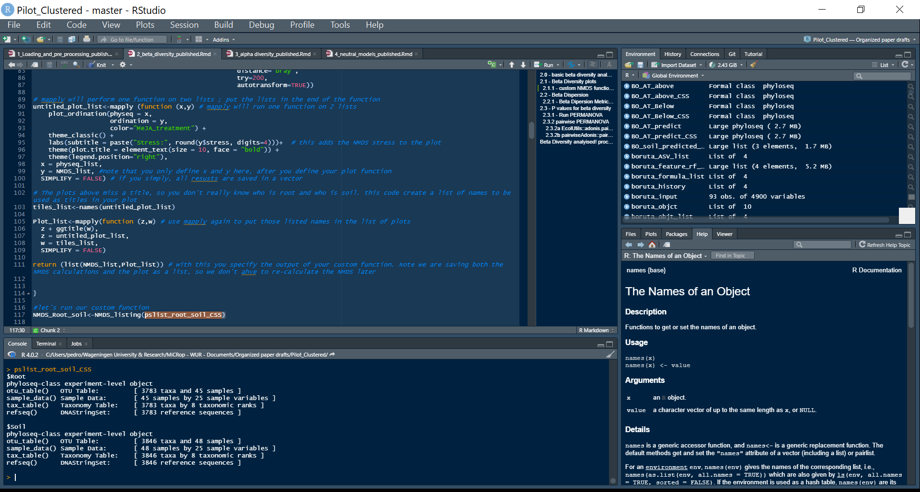
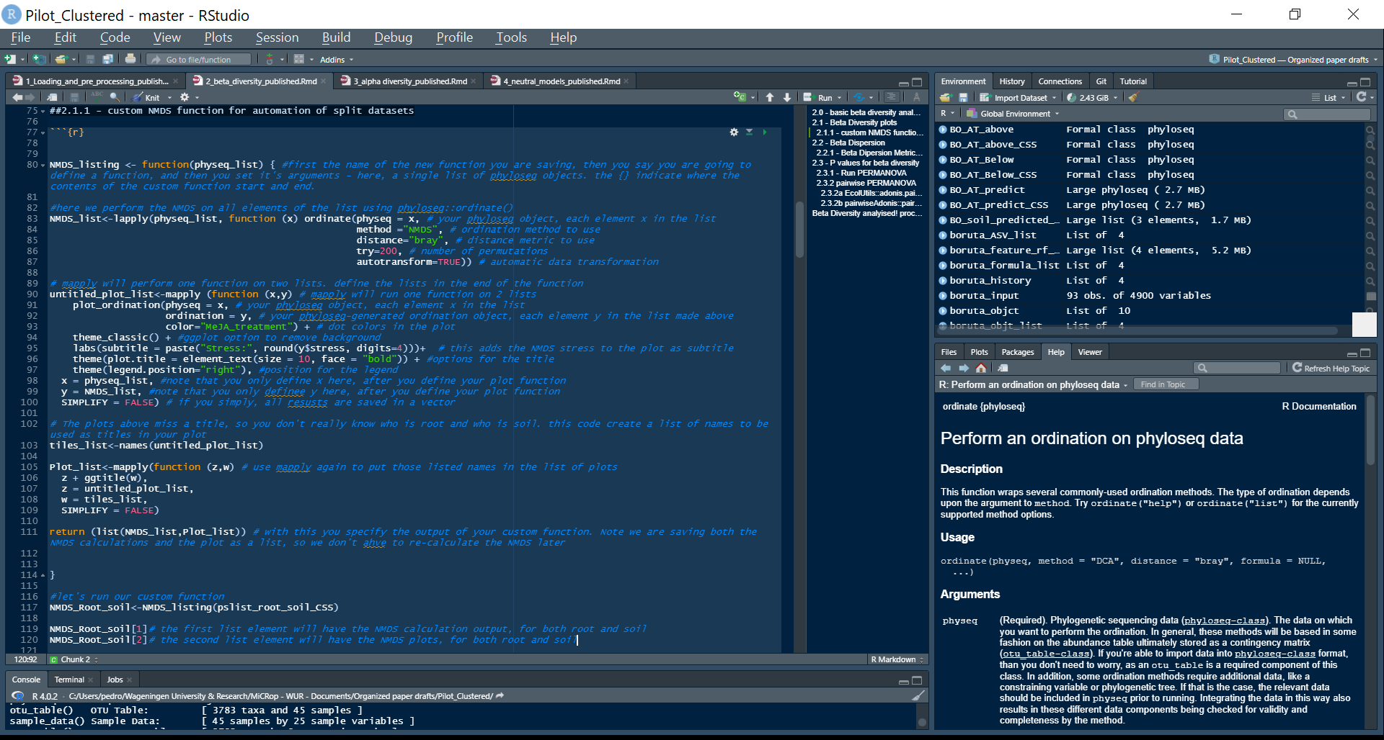
Partition your data so known effects don’t dominate your analysis!
Split your data into lists with metagMisc::phyloseq_sep_variable()
Execute custom functions over a list with lapply(), mapply() and map()
This reduces errors from copy-pasting code
Your anslysis is then more efficient, clear, and reproducible
Plenty of commented real data examples on the scripts I will soon make public
Not many available online tutorials integrating this on real microbiome data
B.oleraceae
soil samples

Slide 9
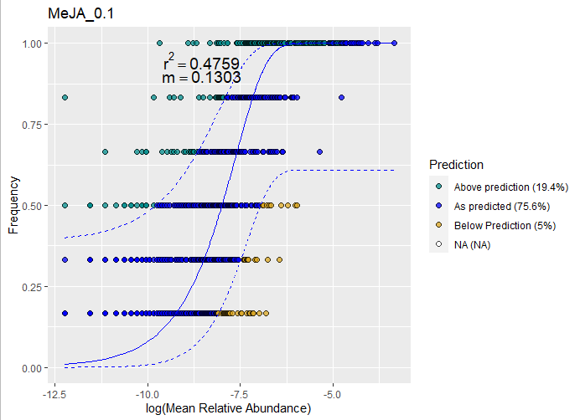
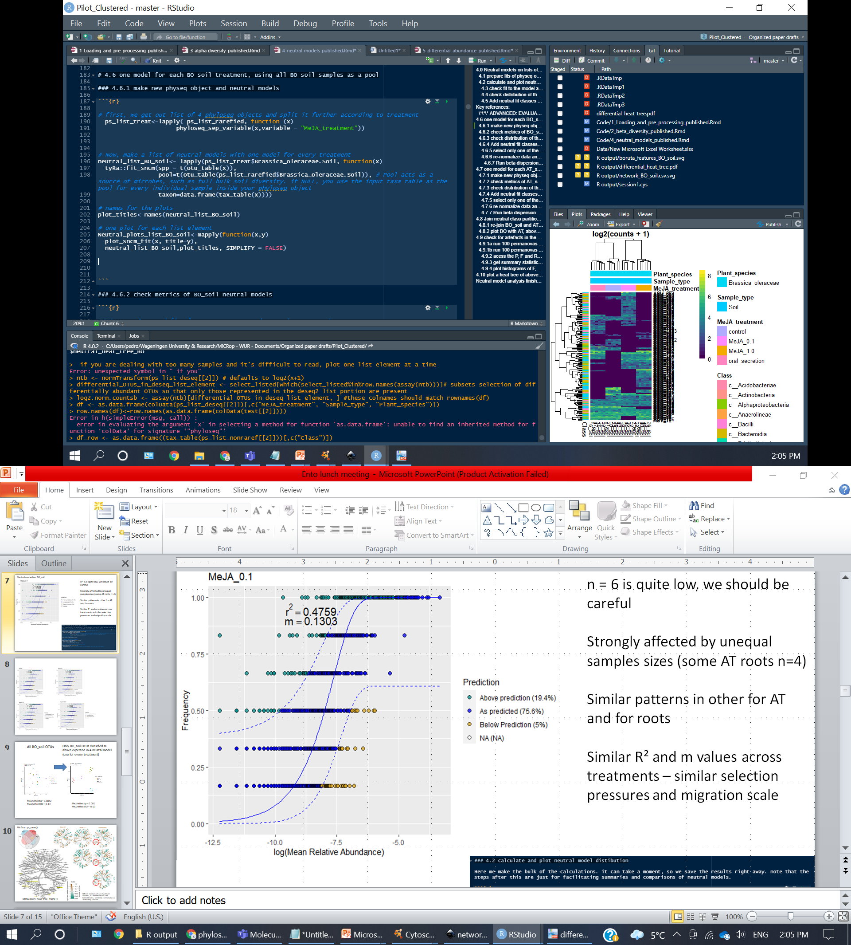
The Sloan Neutral model shows selection pressures and is easy to run
Fits to the neutral model can indicate selection pressure
If the taxa is abundant (has lots of sequences), it should have high frequency (is found in many samples). This is your prediction
Taxa above predictions could be considered as selected in this environment
Fit is calculated with tyRa::fit_sncm on a data-derived parameters
Serves as a proxy for plant-recruited taxa

Slide 10
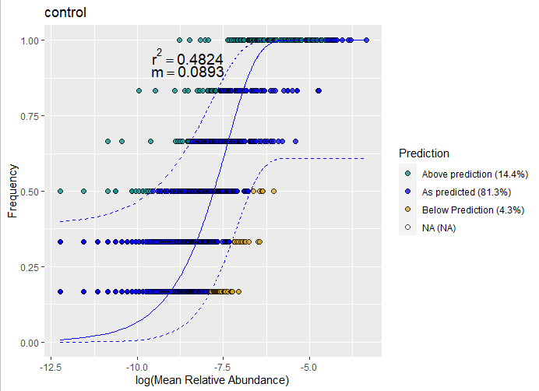

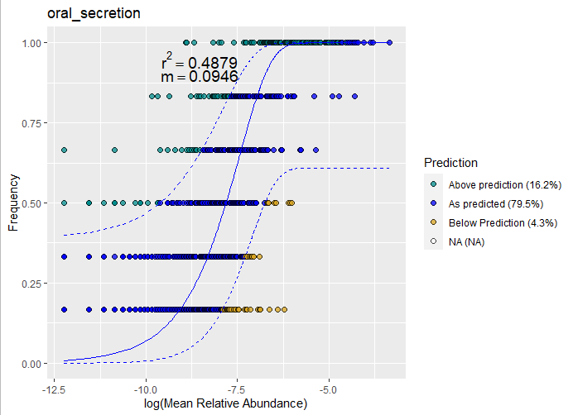
The Sloan Neutral model shows selection and is easy to run
One model for each treatment in B. oleracea soil samples
Fits to the neutral model (r²) were almost identical across treatments
Similar selection pressures
Are the same taxa being selected?
Partition the data again
Only with taxa above predictions

Slide 11
MeJA treatments select markedly different taxa
All 2557 B. Oleraceae soil taxa
Only the 336 B. Oleraceae soil taxa classified as above expected in at least one of the 4 neutral models
MeJA effect p = 0.0842
MeJA effect R2 = 0.14
MeJA effect p = 0.001
MeJA effect R2 = 0.63

Slide 12
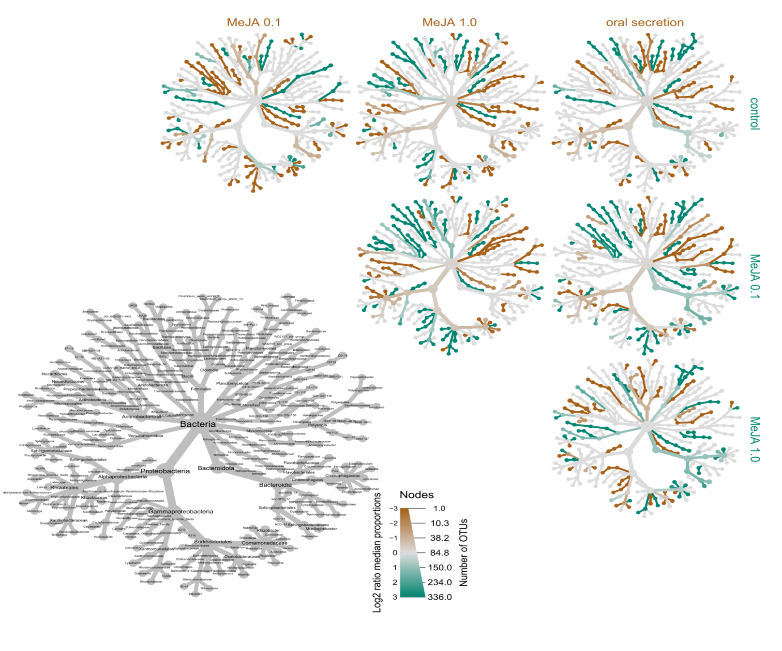
Heat trees show full taxonomy
A full phylogentic tree with colors and sizes representing taxa abundances
Also shows significant pairwise differences
Metacoder:: heat_tree_matrix ()
The trick is to focus on one section at a time…

Slide 13


MicEco:: ps_venn()
Comparing Controls with other treatments
g__67-14
g__Bosea
g__Sporocytophaga
g__A21b
g__pelomonas
Taxa consistently more common in treatments than controls
g__67-14 from o__Solirubrobacterales
g__Bosea from o__Rhizobiaeles
g__A21b from o__Burkholderiales
g__Pelomonas from f_Comonadaeceae
g__Sporocytophaga from o_Cytophagales

Slide 14

Comparing Oral secretion to other treatments…
c__Bacilli
c__Clostridia
Different members of the same taxons are being selected & lost
Class Bacilli and Clostridia
Order Rhizobiales and Burkholderiales
Family Comamonadaceae
Could diversity on these taxons help plant response against herbivores?
o_Rhizobiales
o_Burkholderiales
f_commonadaceae
These 5 taxons
all taxons
Neutrally selected ASVs
Diversity of these taxons was lower in control
Total diversity was lower in control too
Do we have an effect or an artifact? I should make formal test & normalizations!

Slide 15
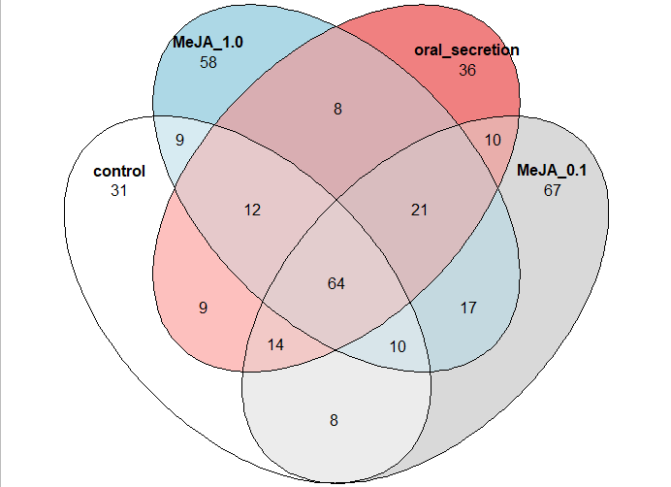
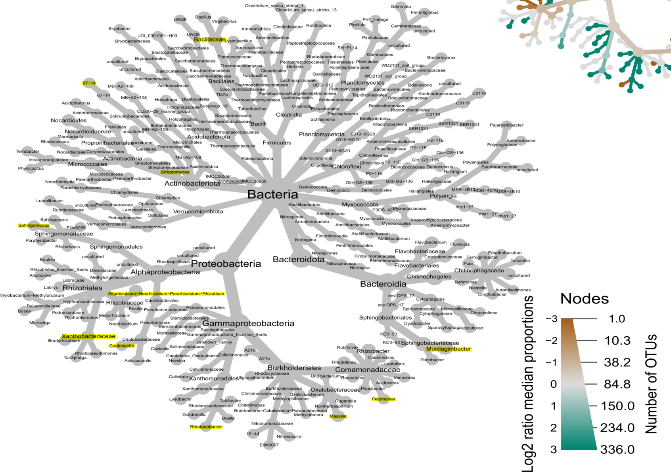
MicEco:: ps_venn()
Finding shared exclusive ASVs
A simpler comparison is still useful!
Here 21 taxa are present in the 3 treatments but absent in control
Diverse, but Proteobacteria seems more represented
MicEco:: ps_venn()
g_Mucilaginibacter produces exopolyssacharides and has been found as beneficial in plants before

Slide 16
MicEco:: ps_venn()
We saw that a selected community subset can be quite different between treatments
We could detect taxons that differed in abundance between these subsets
But all methods have their assumptions and flaws, so let’s try something completely different

Slide 17
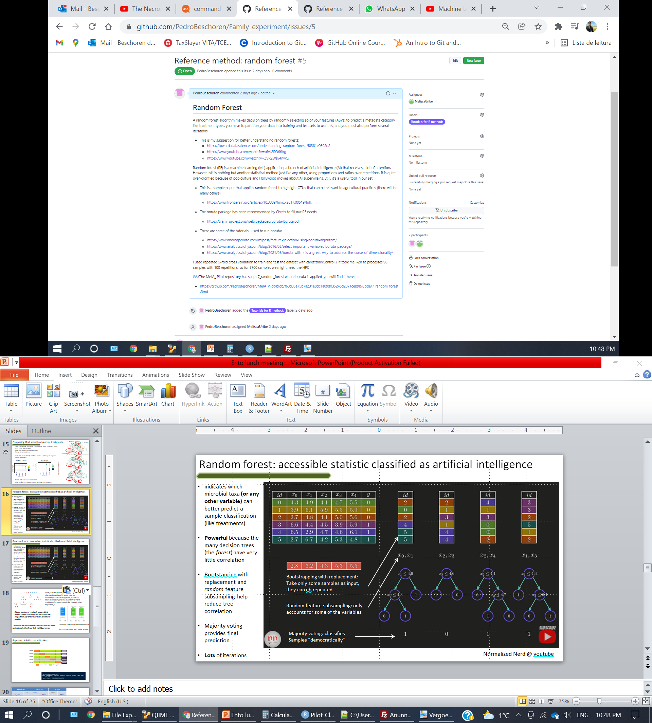
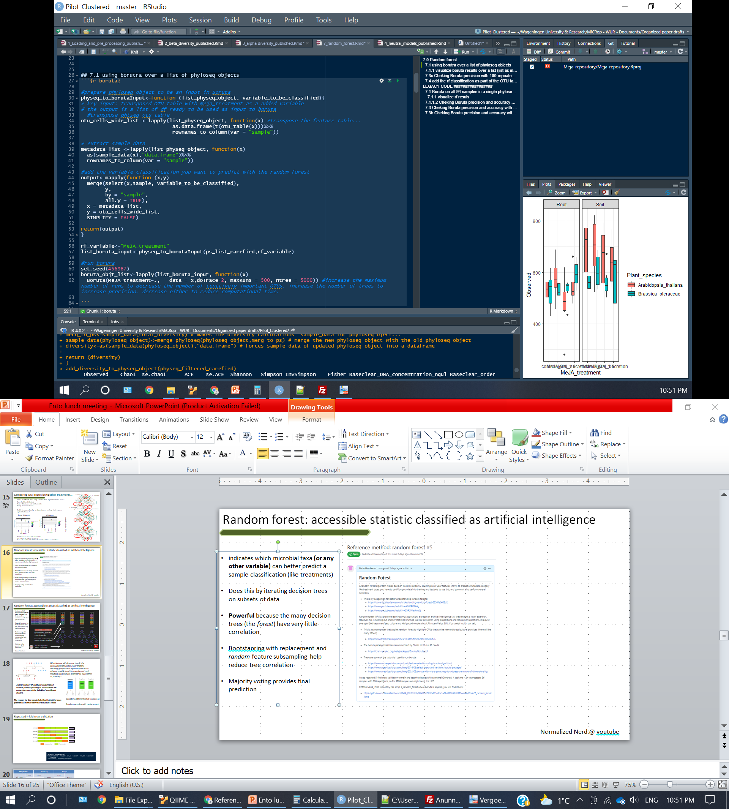
Random forest: machine learning with artificial intelligence
(but really, it’s just statistics)
indicates which microbial taxa (or any other variable) can better predict a sample classification (like treatments)
Does this by iterating many decision trees (forest) on (random) subsets of data
This is run multiple times over training and test dataset splits
Bootstrapping with replacement: Take only some samples as input, they can eb repeated
Random feature subsampling: only accounts for some of the variables
Majority voting: classifies
Samples “democratically”

Slide 18
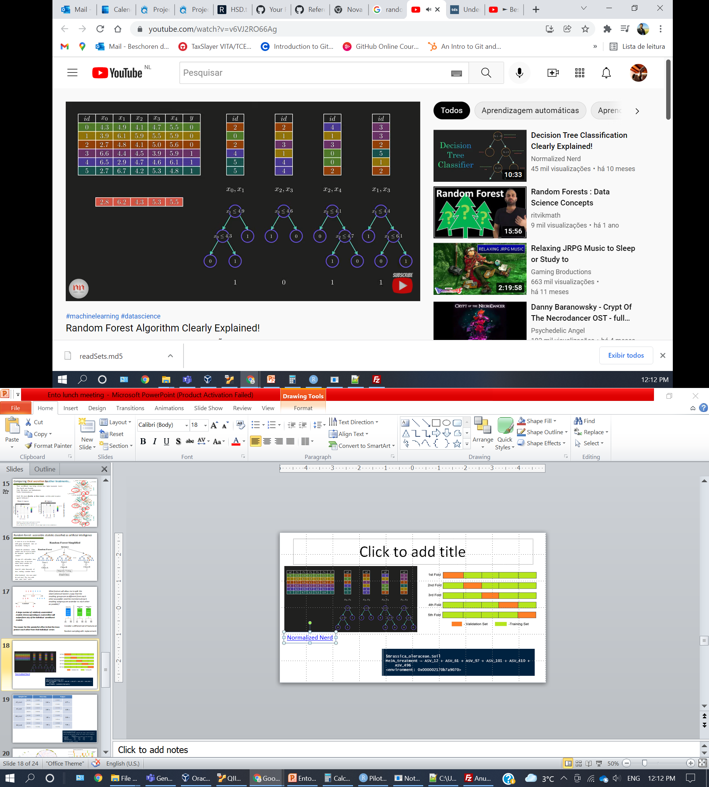
Normalized Nerd @ youtube
Variables
(taxa abudance)
Samples
Treatments

Slide 19
Normalized Nerd @ youtube
Bootstrapping with replacement: Take only some samples as input, they can be repeated

Slide 20
Normalized Nerd @ youtube
Bootstrapping with replacement: Take only some samples as input, they can be repeated
Random feature subsampling: only accounts for some of the variables

Slide 21
Normalized Nerd @ youtube
Bootstrapping with replacement: Take only some samples as input, they can be repeated
Random feature subsampling: only accounts for some of the variables

Slide 22
Normalized Nerd @ youtube
Bootstrapping with replacement: Take only some samples as input, they can be repeated
Random feature subsampling: only accounts for some of the variables
Decision tree: classifies samples according observed data section

Slide 23
Normalized Nerd @ youtube
Test data: partition not used until now
Bootstrapping with replacement: Take only some samples as input, they can be repeated
Random feature subsampling: only accounts for some of the variables
Decision tree: classifies samples according observed data section
Majority voting: classifies test data samples

Slide 24
Normalized Nerd @ youtube
Test data: partition not used until now
Bootstrapping with replacement: Take only some samples as input, they can be repeated
Random feature subsampling: only accounts for some of the variables
Decision tree: classifies samples according observed data section
Majority voting: classifies test data samples

Slide 25
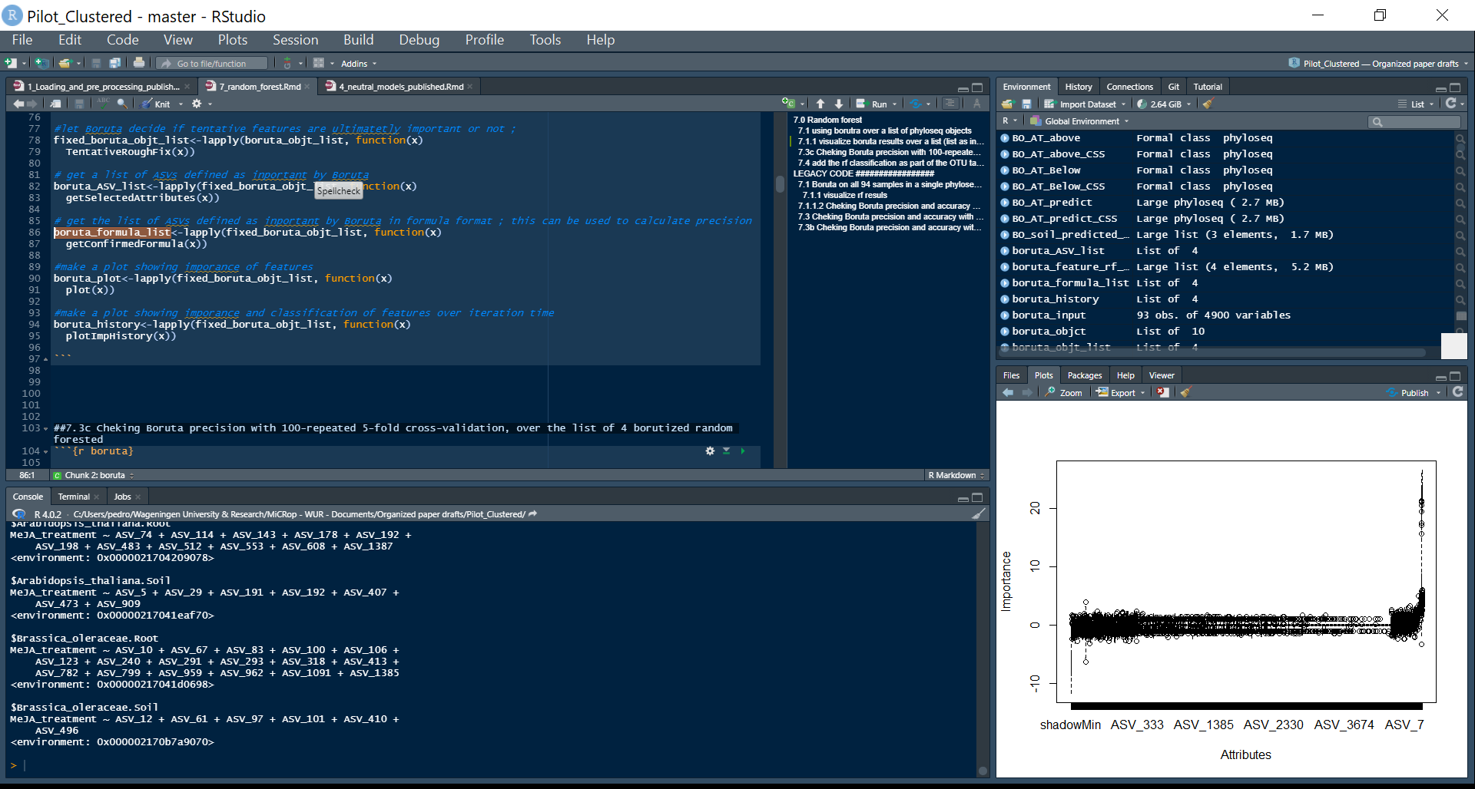
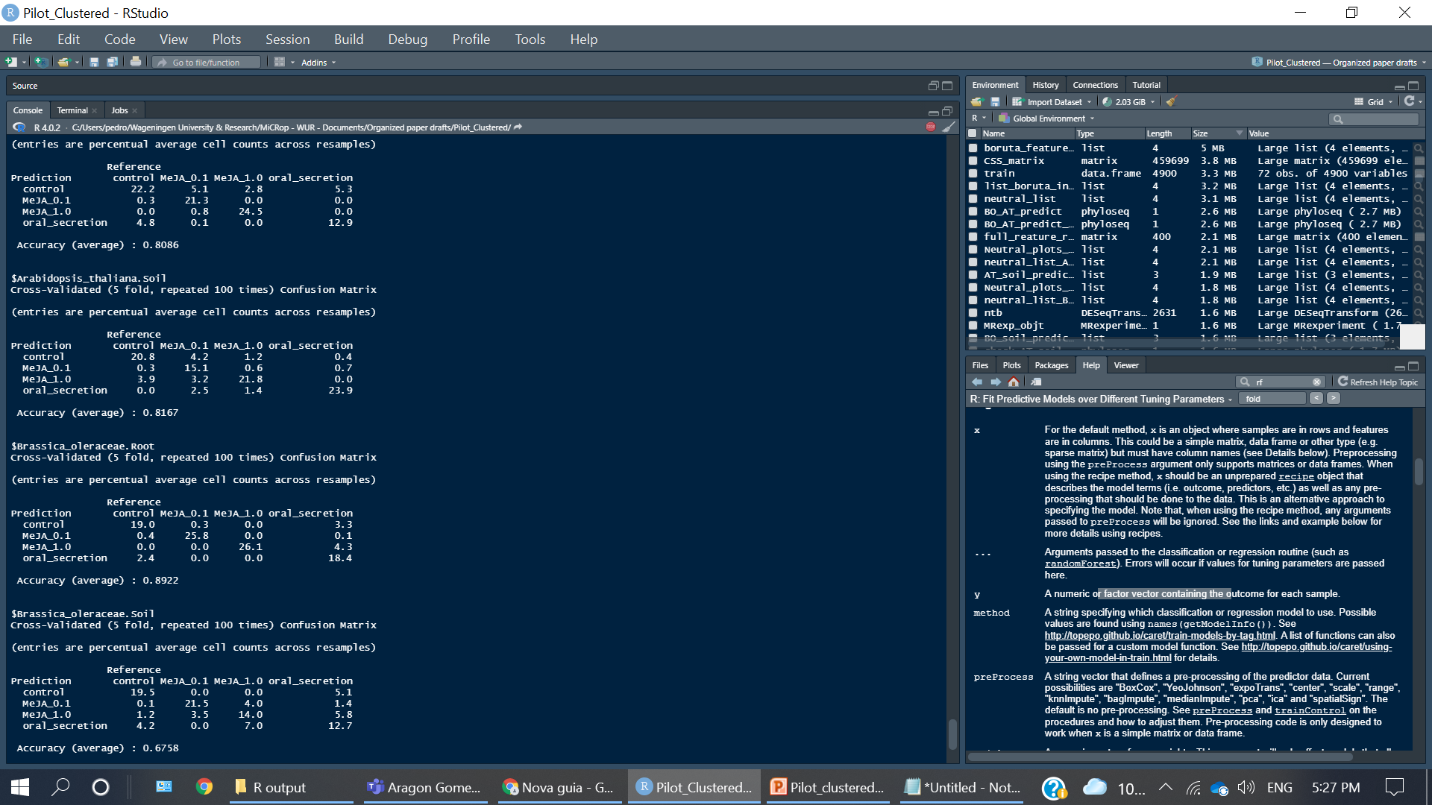
A formula of features to predict sample treatments
Our output is a formula of features
boruta::Boruta() filters features
Caret::trainControl() splits training and data sets
Caret::train() calculates the RF on the feature subset
Caret::confusionMatrix() shows prediciton accuracy
Selected by RF on B.oleraceae soil samples…
g__Nocardioides
g__Pedobacter
g__Mucilaginibacter (x2)
g__Massilia
f__Comamonadaceae
…and neutral models

Slide 26
MicEco:: ps_venn()
We saw that a few taxa can classify our samples, generating a list of candidates for analysis
Some of these taxa were also noted in the neutral model analysis – a confirmation!
But all methods have their assumptions and flaws, so let’s try something completely different

Slide 27
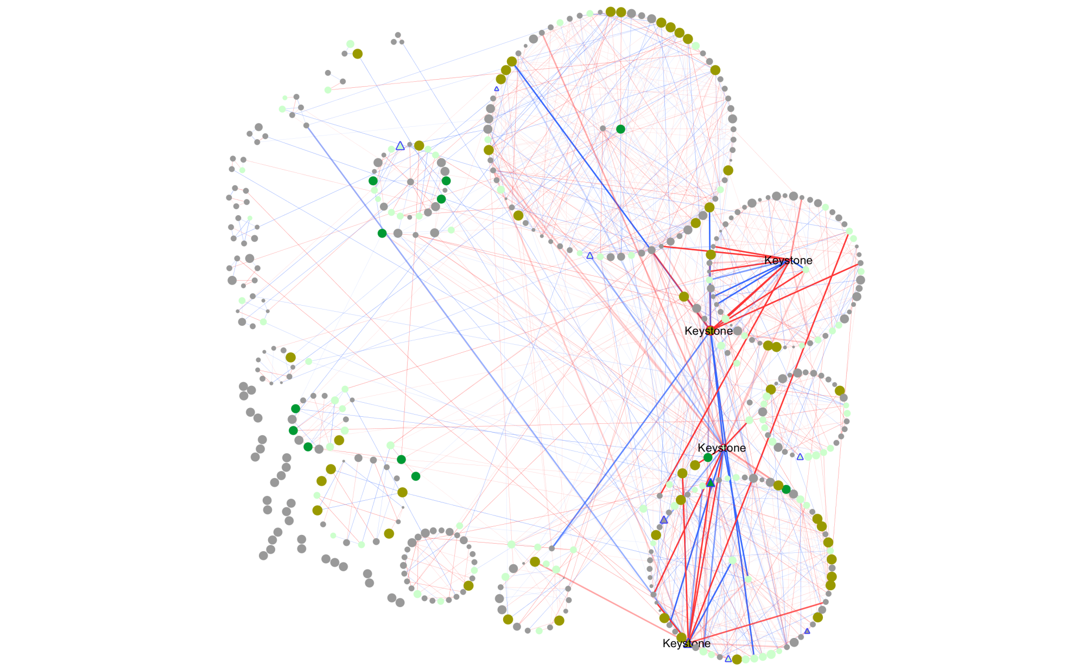
Networks can help us connect these taxa
A group of interacting microbes has a higher functionality than their individual parts
Network analysis can show us correlations and co-variances between these microbes – hints of ecological interactions
It highlights sub-communities and keystone species
Keystone species have a central role within the network
Their removal greatly impacts the ecosystem

Slide 28
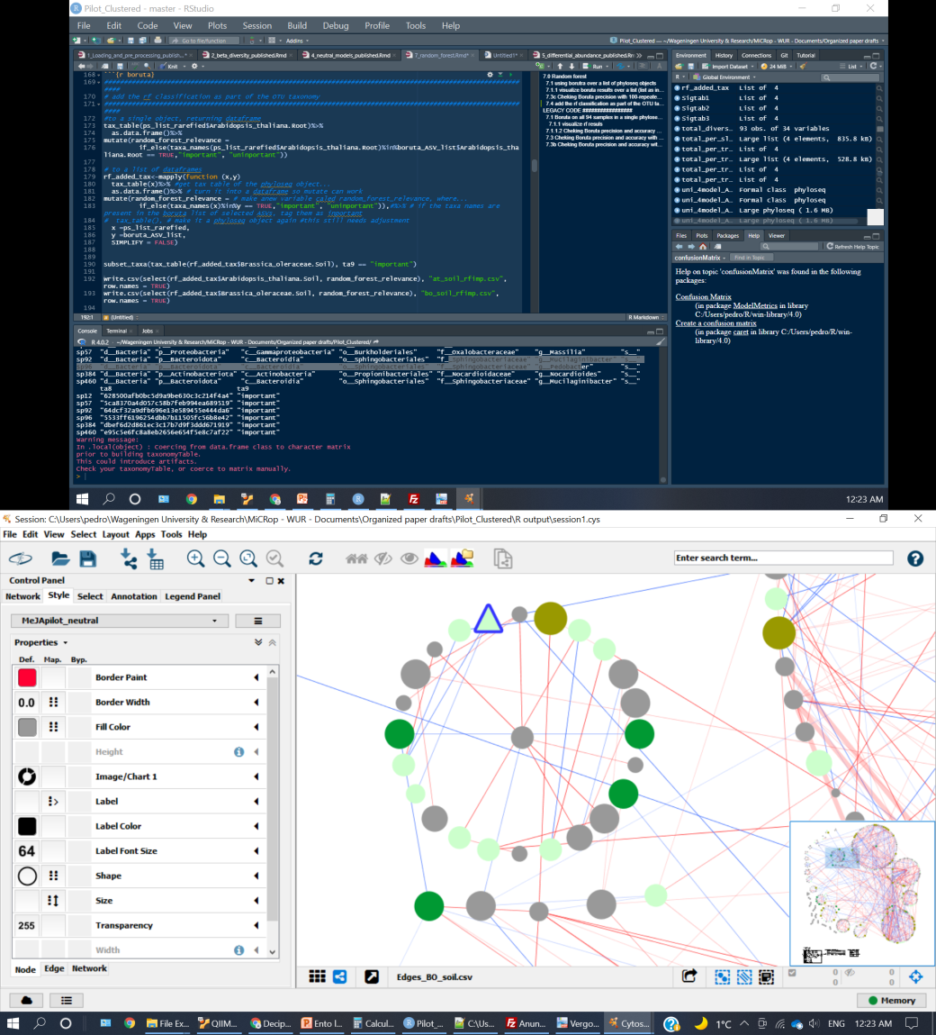
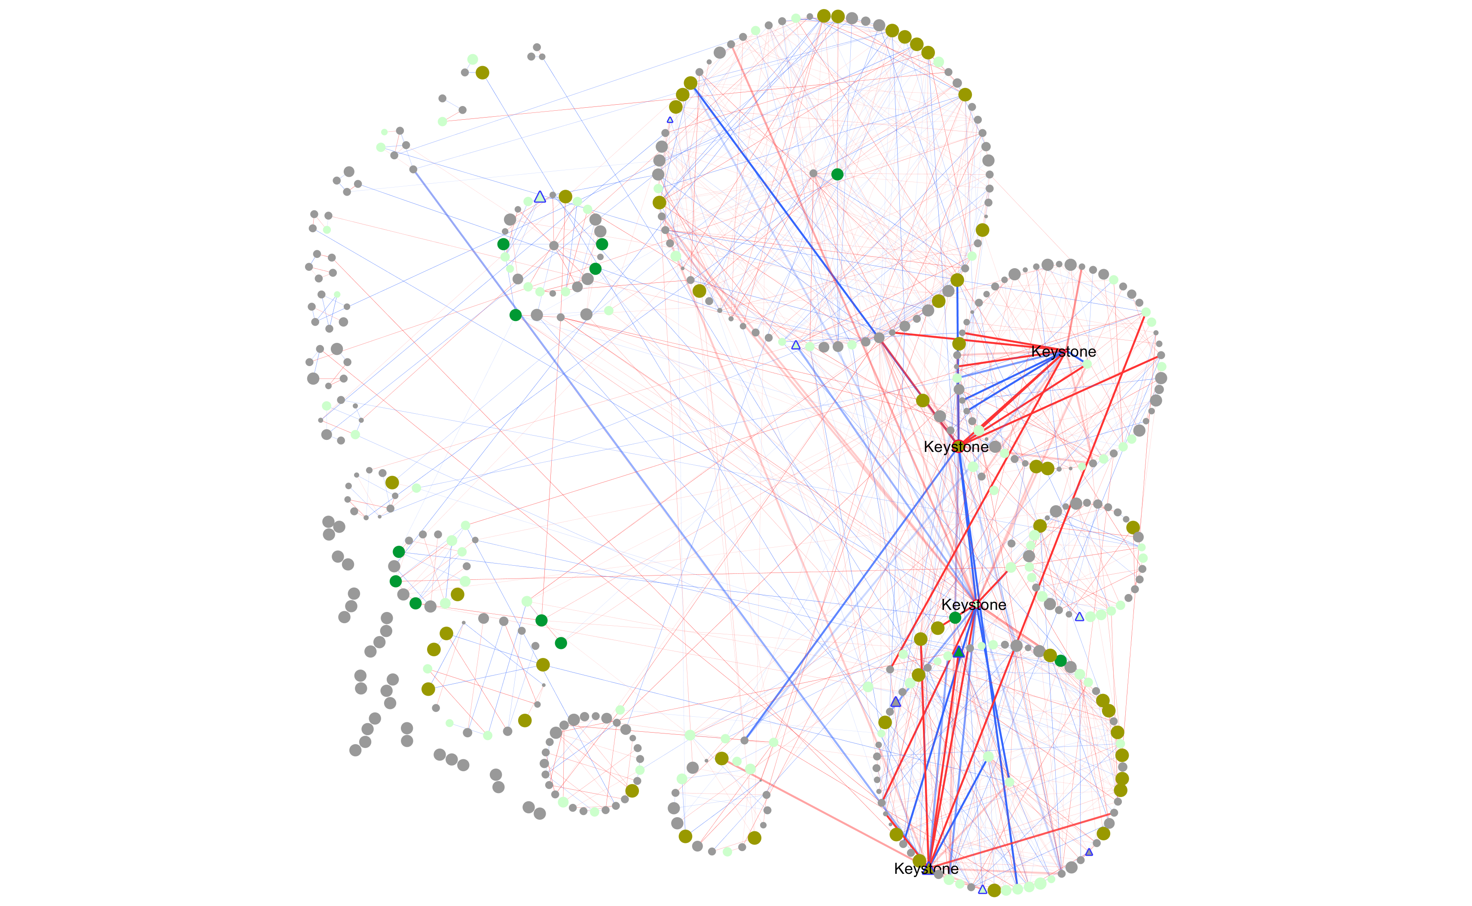
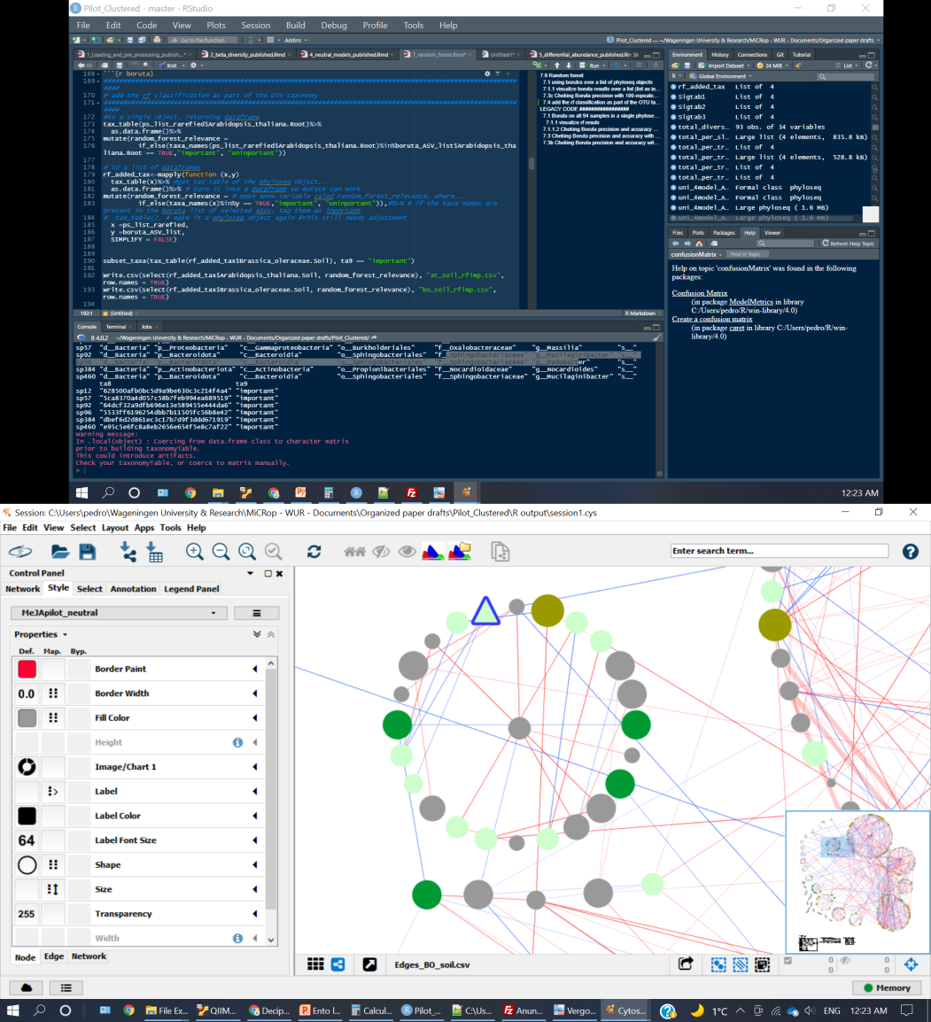



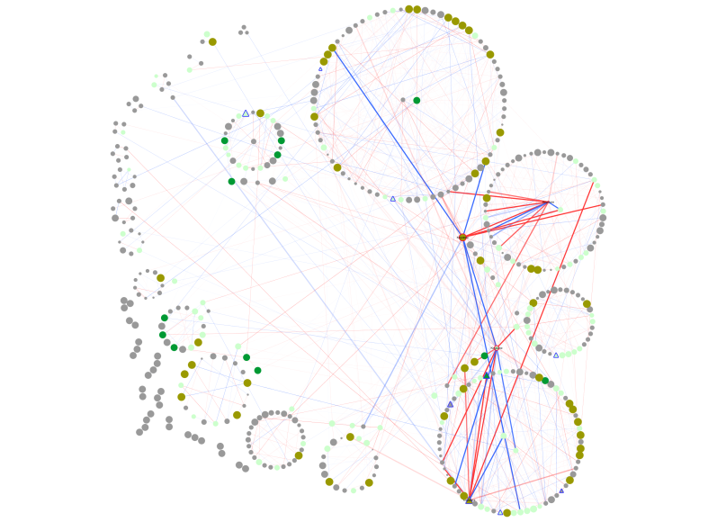
Layers of information in networks
Each dot (network node): a bacterial taxa
Blue links: negative covariances
Red links: positive covariances
Above expected on all treatments and control
Above expected on 1-2 treatments, but not in control
Above expected on all treatments, but not in control
Triangles with blue border:
selected in Random Forest
Has ticker links and label: keystone species
Module: sub-communities that interacts strongly with each other
Module hub: important in structuring a module
Connector: important in connecting different modules

Slide 29
Keystone taxa influence the whole system
g_Nocardioides
Neutrally selected in all treatments
Highlighted as important in RF to classify treatments
Keystone taxa in B. oleracea soils
Now we have justification for in-depth analysis
biocontrol & SA production cited in literature

Slide 30
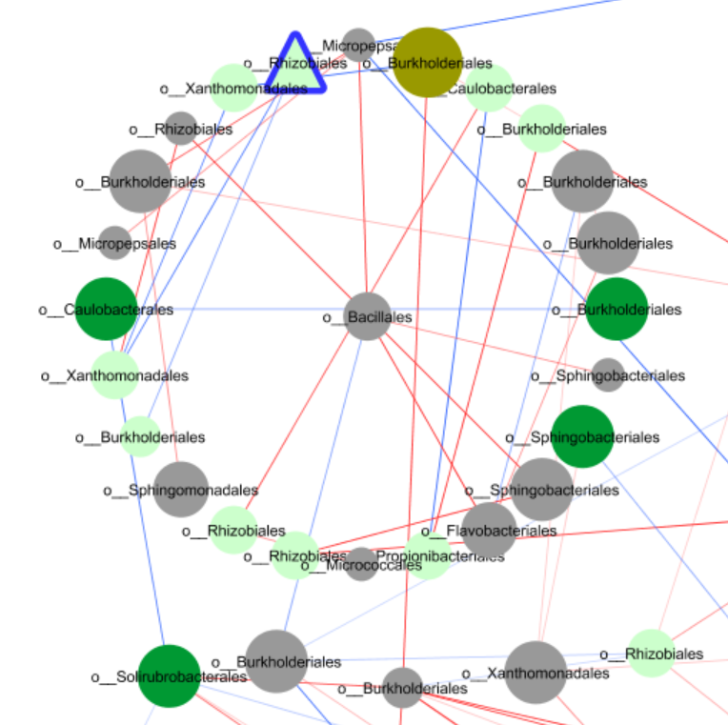
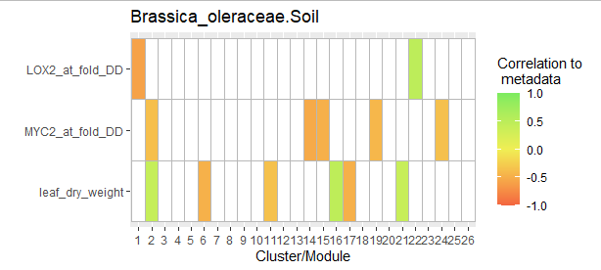
Modules might indicate sub-communities

Slide 31
Mucilaginibacter might be relevant
Well represented in the network, having both central and peripheral roles
Mucilage could be holding a group of bacteria together
Could be driving biofilm formation
g_Mucilaginibacter

Slide 32
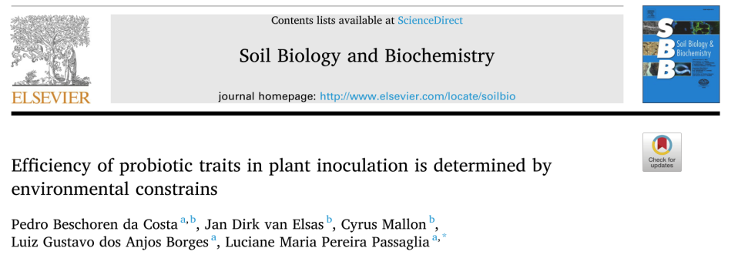
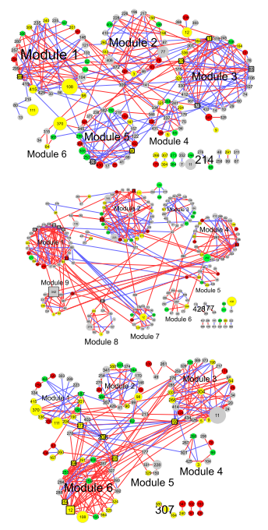
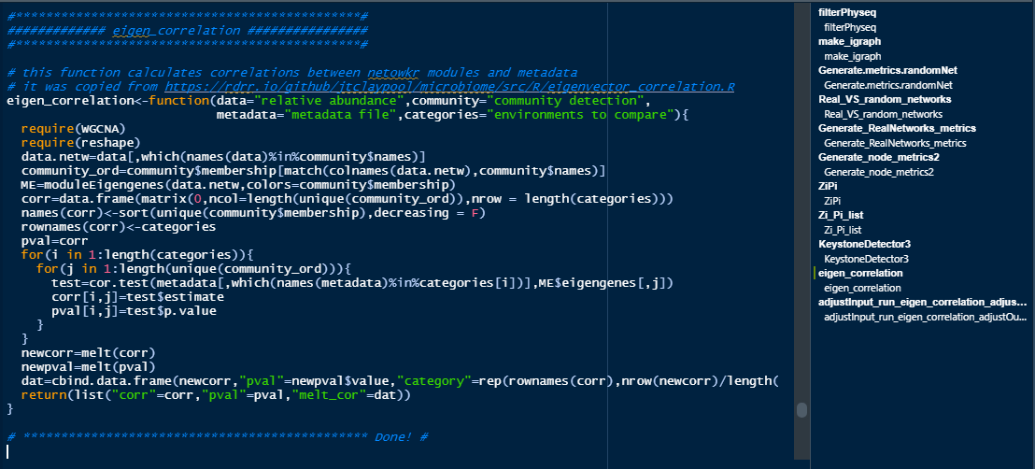
Reproducibility is difficult on networks
Nascent field with few standards and many tools
Filtering and cut-offs can have significant impact
Some decisions are data-dependent
Jargon is a big barrier
Still useful to highlight interesting taxa, describing treatment effects, and suggest consortia composition. Check my paper!
My current code for network analysis:
Is long, heavy and slow
Needs polishing
Filled with custom functions
Requires many packages
Visualization is external in Cytoscape
… but it’s updated and you don’t have to use all features!

Slide 33
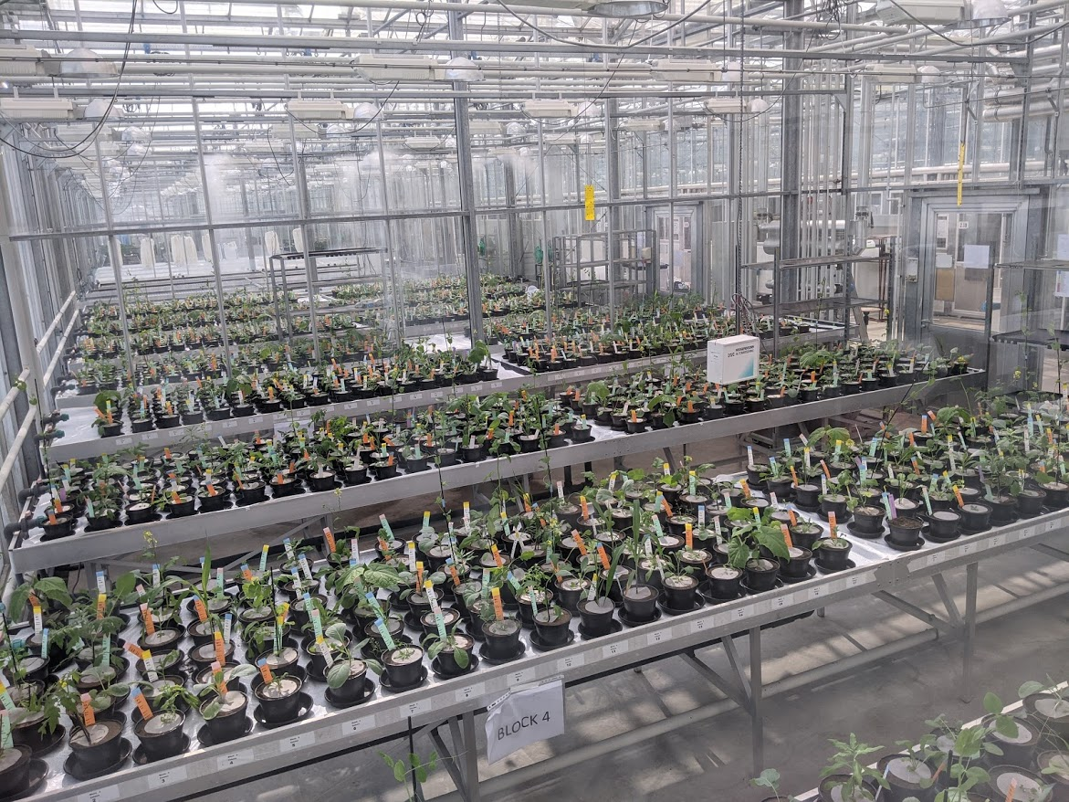


How can you use this?
Ento-WUR has access to updated microbiome analysis tools
Still need publication (and polishing) before becoming public
The documentation can serve as a framework for future work
Still work-intensive to apply!
What is the MeJA effect?
Neutral models indicates very clear microbial selection by treatment
g_Mucilaginibacter could be driving sub-cummunity cohesion
g_Nocardioides could be playing a (very) important role in the system
Final analysis steps still on-going
Thank you!
New dataset: 142 times larger!

